Slide 1


Principles of Information Security,
Fifth Edition
Chapter 11
Security and Personnel

Slide 2
Learning Objectives
Upon completion of this material, you should be able to:
  Describe where and how the information security function should be positioned within organizations
  Explain the issues and concerns related to staffing the information security function
  Enumerate the credentials that information security professionals can earn to gain recognition in the field
  Discuss how an organization’s employment policies and practices can support the information security effort
Principles of Information Security, Fifth Edition
Notes:
Learning Objectives
Upon completion of this material, you should be able to:
Describe where and how the information security function should be positioned within organizations
Explain the issues and concerns related to staffing the information security function
Enumerate the credentials that information security professionals can earn to gain recognition in the field
Discuss how an organization’s employment policies and practices can support the information security effort

Slide 3
Learning Objectives (cont’d)
  Identify the special security precautions that must be taken when using contract workers
  Explain the need for separation of duties
  Describe the special requirements needed to ensure the privacy of personnel data
Principles of Information Security, Fifth Edition
Notes:
Learning Objectives
Identify the special security precautions that must be taken when using contract workers
Explain the need for the separation of duties
Describe the special requirements needed to ensure the privacy of personnel data

Slide 4
Introduction
When implementing information security, there are many human resource issues that must be addressed.
  Positioning and naming
  Staffing
  Assessing impact of information security on every IT function
  Integrating solid information security concepts into personnel management practices
Employees often feel threatened when information security program is being created/enhanced.
Principles of Information Security, Fifth Edition
Notes:
Introduction
When implementing information security, there are many human resource issues that must be addressed
Positioning and naming
Staffing
Assessing impact of information security on every IT function
Integrating solid information security concepts into personnel management practices
Employees often feel threatened when information security program is being created/enhanced

Slide 5
Positioning and Staffing the Security Function
The security function can be placed within:
  IT function
  Physical security function
  Administrative services function
  Insurance and risk management function
  Legal department
IS should balance duty to monitor compliance with needs for education, training, awareness, and customer service.
Principles of Information Security, Fifth Edition
Notes:
Positioning and Staffing the Security Function
The security function can be placed within:
IT function
Physical security function
Administrative services function
Insurance and risk management function
Legal department
IS should balance duty to monitor compliance with needs for education, training, awareness, and customer service

Slide 6
Staffing the Information Security Function
Selecting personnel is based on several criteria, including some not within the control of the organization (supply and demand).
Many professionals enter security market by gaining skills, experience, and credentials.
At present, information security industry is in a period of high demand.
Principles of Information Security, Fifth Edition
Notes:
Staffing the Security Function
Selecting personnel is based on several criteria, including some not within control of organization (supply and demand)
Many professionals enter security market by gaining skills, experience, and credentials
At present, information security industry is in a period of high demand

Slide 7
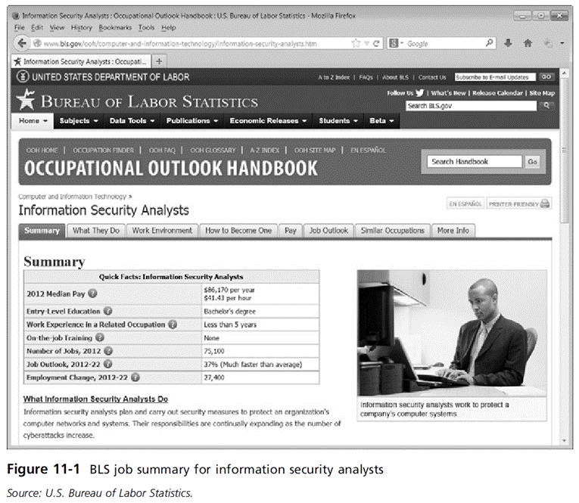
Principles of Information Security, Fifth Edition

Slide 8
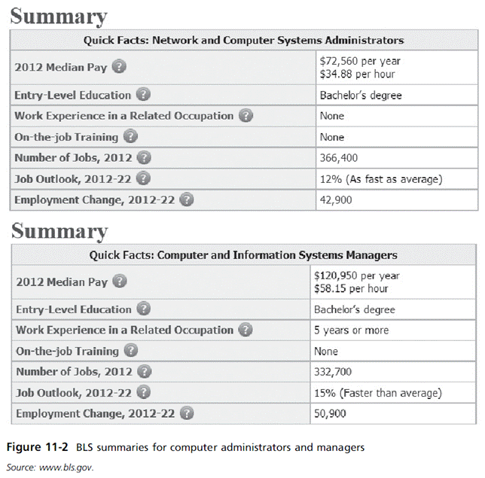
Principles of Information Security, Fifth Edition

Slide 9
Staffing the Information Security Function (cont’d)
Qualifications and requirements
  Establishing better hiring practices requires the following:
    General management should learn more about skills and qualifications for positions.
    Upper management should learn about the budgetary needs of information security function.
    IT and general management should grant appropriate levels of influence and prestige to information security.
  Organizations typically look for technically qualified information security generalist.
Principles of Information Security, Fifth Edition
Notes:
Qualifications and Requirements
Establishing better hiring practices requires the following:
General management should learn more about skills and qualifications for positions
Upper management should learn about budgetary needs of information security function
IT and general management should grant appropriate levels of influence and prestige to information security
Organizations typically look for technically qualified information security generalist

Slide 10
Staffing the Information Security Function (cont’d)
Qualifications and requirements (cont’d)
  Organizations look for candidates who understand:
    How an organization operates at all levels
    Information security is usually a management problem, not a technical problem
    Importance of strong communications and writing skills
    The role of policy in guiding security efforts
    Most mainstream IT technologies
    The terminology of IT and information security
Principles of Information Security, Fifth Edition
Notes:
Qualifications and requirements (cont’d.)
Organizations look for candidates who understand:
How an organization operates at all levels
Information security is usually a management problem, not a technical problem
Importance of strong communications and writing skills
The role of policy in guiding security efforts
Most mainstream IT technologies
The terminology of IT and information security

Slide 11
Staffing the Information Security Function (cont’d)
Qualifications and requirements (cont’d)
  Organizations look for information security professionals who understand (cont’d):
    Threats facing an organization and how they can become attacks
    How to protect an organization’s assets from information security attacks
    How business solutions can be applied to solve specific information security problems
Principles of Information Security, Fifth Edition
Notes:
Qualifications and requirements (cont’d.)
Organizations look for information security professionals who understand (cont’d.):
Threats facing an organization and how they can become attacks
How to protect organization’s assets from information security attacks
How business solutions can be applied to solve specific information security problems

Slide 12
Staffing the Information Security Function (cont’d)
Entry into the information security profession
  Many information security professionals enter the field through one of two career paths:
    Law enforcement and military
    Technical, working on security applications and processes
  Today, students select and tailor degree programs to prepare for work in information security.
  Organizations can foster greater professionalism by matching qualified candidates to clearly defined roles in information security.
Principles of Information Security, Fifth Edition
Notes:
Entry into the Security Profession
Many information security professionals enter the field through one of two career paths:
Law enforcement and military
Technical, working on security applications and processes
Today, students select and tailor degree programs to prepare for work in information security
Organizations can foster greater professionalism by matching qualified candidates to clearly defined roles in information security

Slide 13
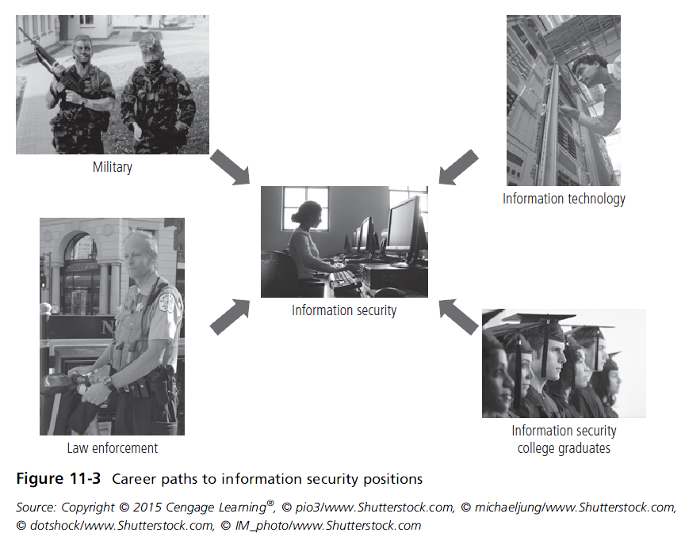
Principles of Information Security, Fifth Edition

Slide 14
Staffing the Information Security Function (cont’d)
Information security positions
  Use of standard job descriptions can increase the degree of professionalism and improve the consistency of roles and responsibilities between organizations.
  Charles Cresson Wood’s book Information Security Roles and Responsibilities Made Easy offers a set of model job descriptions.
Principles of Information Security, Fifth Edition
Notes:
Information Security Positions
The use of standard job descriptions can increase the degree of professionalism in the information security field as well as improve the consistency of roles and responsibilities between organizations.
Organizations that are revising the roles and responsibilities of InfoSec staff can consult references like Wood’s book Information Security Roles and Responsibilities Made Easy, or Schwartz, et al’s report “InfoSec Staffing Help Wanted”.

Slide 15
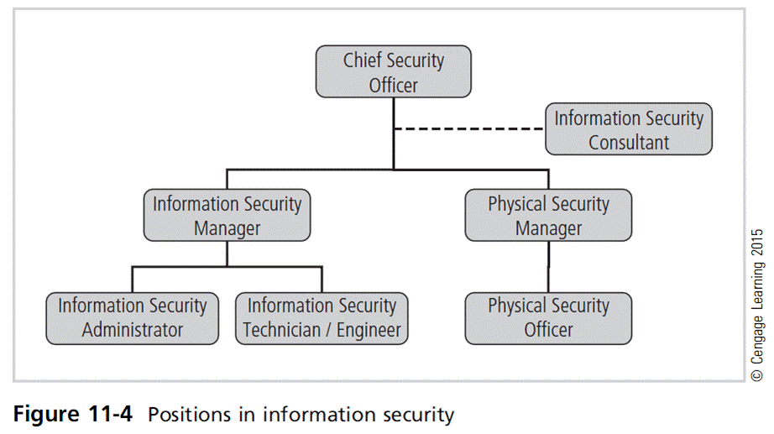
Principles of Information Security, Fifth Edition

Slide 16
Information Security Positions
Chief information security officer (CISO)
  Top information security officer; frequently reports to chief information officer (CIO)
  Manages the overall information security program
  Drafts or approves information security policies
  Works with the CIO on strategic plans
  Develops information security budgets
  Sets priorities for purchase/implementation of information security projects and technology
Principles of Information Security, Fifth Edition
Notes:
Chief Information Security Officer
This position is typically considered the top information security officer in the organization.
The CISO is usually not an executive-level position and frequently reports to the Chief Information Officer.
Though CISOs are business managers first and technologists second, they must also be conversant in all areas of security, including technical, planning, and policy.
The CISO performs the following functions:
Manages the overall InfoSec program
Drafts or approves information security policies
Works with the CIO on strategic plans, develops tactical plans, and works with security managers on operational plans
Develops InfoSec budgets based on funding
Sets priorities for the purchase and implementation of InfoSec projects & technology
Makes decisions or recommendations on the recruiting, hiring, and firing of security staff
Acts as the spokesperson for the security team
Qualifications and Position Requirements
The most common qualification expected for this type of position is the Certified Information Systems Security Professional.
A graduate degree in one of the following areas is also probably required: criminal justice, business, technology, or other related fields.
To qualify for this level position, the candidate demonstrates experience as a security manager and presents experience with planning, policy, and budgets.

Slide 17
Information Security Positions (cont’d)
Chief information security officer (CISO) (cont’d)
  Makes recruiting, hiring and firing decisions or recommendations
  Acts as spokesperson for information security team
  Typical qualifications: accreditation, graduate degree, experience
Chief security officer (CSO)
  CISO’s position may be combined with physical security responsibilities
  Knowledgeable in both IS requirements and “guards, gates, and guns” approach to security
Principles of Information Security, Fifth Edition

Slide 18
Information Security Positions (cont’d)
Security manager
  Accountable for day-to-day operation of information security program
  Accomplishes objectives as identified by CISO, resolves issues identified by technicians
  Typical qualifications: often have accreditation; ability to draft middle- and lower-level policies, standards, and guidelines; budgeting, project management, and hiring and firing; ability to manage technicians
Principles of Information Security, Fifth Edition
Notes:
Security Manager
Accountable for day-to-day operation of information security program
Accomplish objectives as identified by CISO, resolve issues identified by technicians
Typical qualifications: often have accreditation; ability to draft middle- and lower-level policies, standards, and guidelines; budgeting, project management, and hiring and firing; ability manage technicians

Slide 19
Information Security Positions (cont’d)
Security technician
  Technically qualified employees tasked to configure security hardware and software
  Tend to be specialized
  Typical qualifications:
    Varied; organizations prefer expert, certified, proficient technician
    Some experience with a particular hardware and software package
    Actual experience in using a technology usually required
Principles of Information Security, Fifth Edition
Notes:
Security Technician
Technically qualified employees tasked to configure security hardware and software
Tend to be specialized
Typical qualifications:
Varied; organizations prefer expert, certified, proficient technician
Some experience with a particular hardware and software package
Actual experience in using a technology usually required

Slide 20
Credentials for Information Security Professionals
Many organizations seek industry-recognized certifications.
Most existing certifications are relatively new and not fully understood by hiring organizations.
Principles of Information Security, Fifth Edition
Notes:
Credentials of Information Security Professionals
Many organizations seek industry-recognized certifications
Most existing certifications are relatively new and not fully understood by hiring organizations

Slide 21
Certifications
(ISC)² Certifications
  Certified Information Systems Security Professional (CISSP)
  Systems Security Certified Practitioner (SSCP)
  Certified Secure Software Lifecycle Professional (CSSLP)
  Associate of (ISC)²
ISACA Certifications
  Certified Information Systems Manager(CISM)
  Certified Information Security Auditor (CISA)
  Certified in the Governance of Enterprise IT (CGEIT)
  Certified in Risk and Information Systems Control (CRISC)
Principles of Information Security, Fifth Edition
Notes:
Certifications
(ISC)² Certifications
Certified Information Systems Security Professional (CISSP)
Systems Security Certified Practitioner (SSCP)
Certified Secure Software Lifecycle Professional (CSSLP)
Associate of (ISC)²
ISACA Certifications
Certified Information Systems Manager(CISM)
Certified Information Security Auditor (CISA)
Certified in the Governance of Enterprise IT (CGEIT)
Certified in Risk and Information Systems Control (CRISC)

Slide 22
Certifications (cont’d)
SANS Global Information Assurance Certification (GIAC)
EC Council Certified CISO (ClCISO)
CompTIA’s Security+
Certified Computer Examiner (CCE)
Principles of Information Security, Fifth Edition
Notes:
Certifications
SANS Global Information Assurance Certification (GIAC)
EC Council Certified CISO (ClCISO)
CompTIA’s Security+
Certified Computer Examiner (CCE)

Slide 23
Certification Costs
More preferred certifications can be expensive.
Even experienced professionals find exams difficult without some review.
Many candidates engage in individual or group study sessions and purchase exam review books.
Before attempting a certification exam, do all homework and review exam criteria, its purpose, and requirements to ensure that the time and energy spent pursuing certification are worthwhile.
Principles of Information Security, Fifth Edition
Notes:
Certification Costs
More preferred certifications can be expensive
Even experienced professionals find exams difficult without some review
Many candidates engage in individual or group study sessions and purchase exam review books
Before attempting a certification exam, do all homework and review exam criteria, its purpose, and requirements to ensure that the time and energy spent pursuing certification are worthwhile

Slide 24
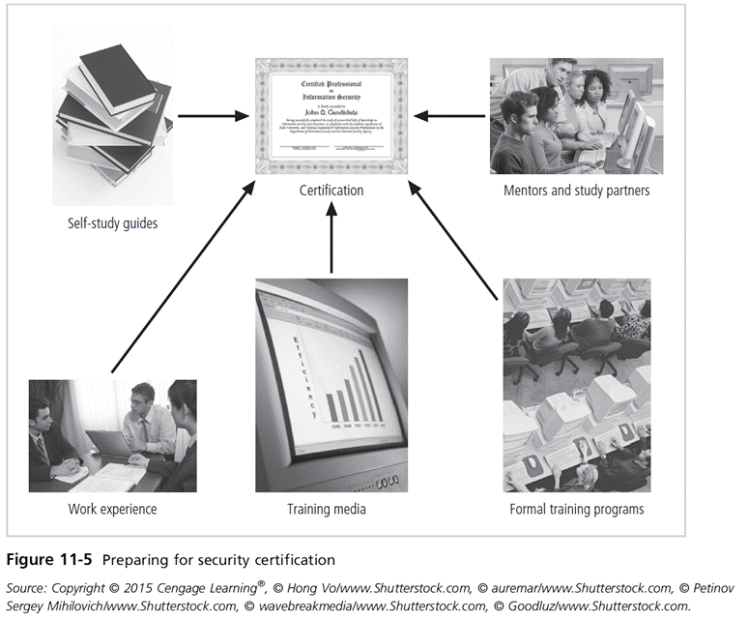
Principles of Information Security, Fifth Edition

Slide 25
Advice for Information Security Professionals
Always remember: business before technology
Technology provides elegant solutions for some problems, but only exacerbates others.
Never lose sight of goal: protection.
Be heard and not seen.
Know more than you say; be more skillful than you let on.
Speak to users, not at them.
Your education is never complete.
Principles of Information Security, Fifth Edition
Notes:
Advice for Information Security Professionals
Always remember: business before technology
Technology provides elegant solutions for some problems, but only exacerbates others
Never lose sight of goal: protection
Be heard and not seen
Know more than you say; be more skillful than you let on
Speak to users, not at them
Your education is never complete

Slide 26
Employment Policies and Practices
An organization should make information security a documented part of every employee’s job description.
Management community of interest should integrate solid concepts for information security into the organization’s employment policies and practices.
Principles of Information Security, Fifth Edition
Notes:
Employment Policies and Practices
Organization should make information security a documented part of every employee’s job description
Management community of interest should integrate solid information solid concepts for information security into organization’s employment policies and practices

Slide 27
Employment Policies and Practices (cont’d)
From information security perspective, hiring of employees is a responsibility laden with potential security pitfalls.
CISO and information security manager should work with Human Resources department to incorporate information security into guidelines used for hiring all personnel.
Principles of Information Security, Fifth Edition
Notes:
Employment Policies and Practices
From information security perspective, hiring of employees is a responsibility laden with potential security pitfalls
CISO and information security manager should work with Human Resources department to incorporate information security into guidelines used for hiring all personnel

Slide 28
Job Descriptions
Integrating information security perspectives into hiring process begins with reviewing and updating all job descriptions.
An organization should avoid revealing access privileges to prospective employees when advertising open positions.
Principles of Information Security, Fifth Edition
Notes:
Job Descriptions
Integrating information security perspectives into hiring process begins with reviewing and updating all job descriptions
Organization should avoid revealing access privileges to prospective employees when advertising open positions

Slide 29
Interviews
An opening within the information security department creates a unique opportunity for the security manager to educate HR on certifications, experience, and qualifications of a good candidate.
Information security should advise HR to limit information provided to the candidate on the responsibilities and access rights of the new hire.
For the organizations that include on-site visits as part of interviews, it’s important to exercise caution when showing candidate around facility.
Principles of Information Security, Fifth Edition
Notes:
Interviews
An opening within the information security department creates a unique opportunity for the security manager to educate HR on certifications, experience, and qualifications of a good candidate
Information security should advise HR to limit information provided to the candidate on the responsibilities and access rights of the new hire
For organizations that include on-site visits as part of interviews, it’s important to exercise caution when showing candidate around facility

Slide 30
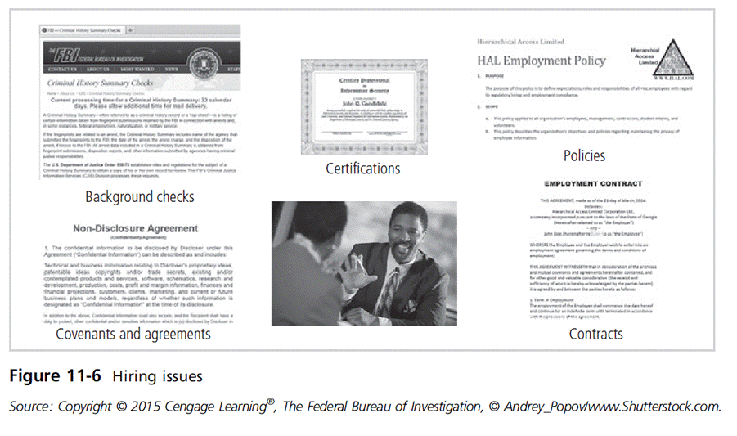
Principles of Information Security, Fifth Edition

Slide 31
Background Checks
Should be conducted before organization extends offer to a candidate
Investigation into a candidate’s past
Background checks differ in the level of detail and depth with which a candidate is examined.
May include identity check, education and credential check, previous employment verification, references check, worker’s compensation history, motor vehicle records, drug history, credit history, and more
Principles of Information Security, Fifth Edition
Notes:
Background Checks
Should be conducted before organization extends offer to candidate
Investigation into a candidate’s past
Background checks differ in level of detail and depth with which candidate is examined
May include identity check, education and credential check, previous employment verification, references check, worker’s compensation history, motor vehicle records, drug history, credit history, and more

Slide 32
Employment Contracts
Once a candidate has accepted a job offer, employment contract becomes an important security instrument.
Many security policies require an employee to agree in writing to monitoring and nondisclosure agreements.
Policies governing employee behavior may be classified as “employment contingent upon agreement,” whereby employee must agree to conform with the policies before being hired.
Principles of Information Security, Fifth Edition
Notes:
Employment Contracts
Should be conducted before organization extends offer to candidate
Investigation into a candidate’s past
Background checks differ in level of detail and depth with which candidate is examined
May include identity check, education and credential check, previous employment verification, references check, worker’s compensation history, motor vehicle records, drug history, credit history, and more

Slide 33
New Hire Orientation
New employees should receive extensive information security briefing on policies, procedures, and requirements for information security.
Levels of authorized access should be outlined; training is provided on secure use of information systems
By the time employees start, they should be thoroughly briefed on security components and their rights and responsibilities.
Principles of Information Security, Fifth Edition
Notes:
New Hire Orientation
New employees should receive extensive information security briefing on policies, procedures, and requirements for information security
Levels of authorized access should be outlined; training provided on secure use of information systems
By the time employees start, they should be thoroughly briefed on security components and their rights and responsibilities

Slide 34
On-the-Job Security Training
An organization should integrate security awareness education into job orientation and security training.
Keeping security at the forefront of employees’ minds helps minimize their mistakes and is an important part of information security awareness mission.
External and internal seminars should also be used to increase security awareness for all employees, particularly security employees.
Principles of Information Security, Fifth Edition
Notes:
On-the-Job Security Training
Organization should integrate security awareness education into job orientation and security training
Keeping security at the forefront of employees’ minds helps minimize their mistakes and is an important part of information security awareness mission
External and internal seminars should also be used to increase security awareness for all employees, particularly security employees

Slide 35
Evaluating Performance
Organizations should incorporate information security components into employee performance evaluations.
Employees pay close attention to job performance evaluations.
  Are more likely to take information security seriously if violations are documented in them
Principles of Information Security, Fifth Edition
Notes:
Performance Evaluation
Organizations should incorporate information security components into employee performance evaluations
Employees pay close attention to job performance evaluations
Are more likely to take information security seriously if violations documented in them

Slide 36
Termination
When employee leaves organization, security-related issues arise.
Key issue is continuity of protection of all information to which employee had access.
After having delivered keys, keycards, and other business property, the former employee should be escorted from the premises.
Many organizations use an exit interview to remind former employee of contractual obligations and to obtain feedback.
Principles of Information Security, Fifth Edition
Notes:
Termination
When employee leaves organization, security-related issues arise
Key issue is continuity of protection of all information to which employee had access
After having delivered keys, keycards, and other business property, the former employee should be escorted from premises
Many organizations use an exit interview to remind former employee of contractual obligations and to obtain feedback

Slide 37
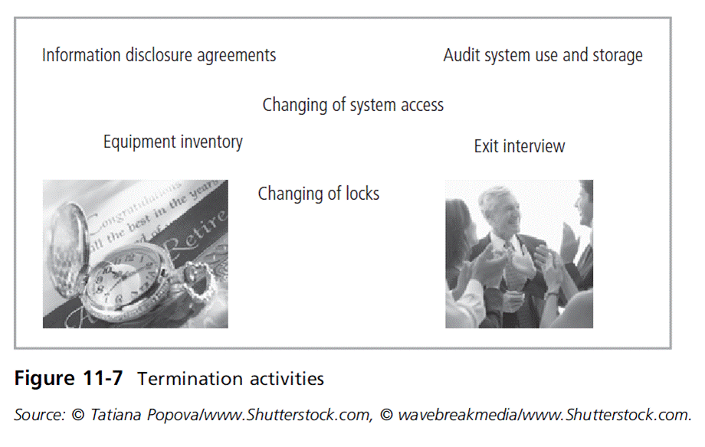
Principles of Information Security, Fifth Edition

Slide 38
Termination (cont’d)
Hostile departures include termination for cause, permanent downsizing, temporary layoffs, or some instances of quitting.
  Before the employee is aware, all logical and keycard access is terminated.
  Employee collects all belongings and surrenders all keys, keycards, and other company property.
  Employee is then escorted out of the building.
Principles of Information Security, Fifth Edition
Notes:
Hostile Departure
Hostile departures include termination for cause, permanent downsizing, temporary layoffs, or some instances of quitting
Before employee is aware, all logical and keycard access is terminated
Employee collects all belongings and surrenders all keys, keycards, and other company property
Employee is then escorted out of the building

Slide 39
Termination (cont’d)
Friendly departures include resignation, retirement, promotion, or relocation.
  Employee may be notified well in advance of departure date.
  More difficult for the security to maintain positive control over the employee’s access and information usage.
  Employee accounts usually continue with new expiration date.
  Employees come and go at will, collect their own belongings, and leave on their own.
Principles of Information Security, Fifth Edition
Notes:
Friendly Departure
Friendly departures include resignation, retirement, promotion, or relocation
Employee may be notified well in advance of departure date
More difficult for security to maintain positive control over employee’s access and information usage
Employee accounts usually continue with new expiration date
Employees come and go at will, collect their own belongings, and leave on their own

Slide 40
Termination (cont’d)
Offices and information used by the employee must be inventoried; files stored or destroyed; and property returned to organizational stores.
Possible that employees foresee departure well in advance and begin collecting organizational information for their future employment
Only by scrutinizing systems logs after the employee has departed can the organization determine if there has been a breach of policy or a loss of information.
If information has been illegally copied or stolen, report an incident and follow the appropriate policy.
Principles of Information Security, Fifth Edition
Notes:
Termination
Offices and information used by the employee must be inventoried; files stored or destroyed; and property returned to organizational stores
Possible that employees foresee departure well in advance and begin collecting organizational information for their future employment
Only by scrutinizing systems logs after employee has departed can organization determine if there has been a breach of policy or a loss of information
If information has been illegally copied or stolen, report an incident and follow the appropriate policy

Slide 41
Security Considerations for Temporary Employees, Consultants, and Other Workers
Individuals not subject to screening, contractual obligations, and eventual secured termination often have access to sensitive organizational information.
Relationships with these individuals should be carefully managed to prevent possible information leak or theft.
Principles of Information Security, Fifth Edition
Notes:
Security Considerations for Temporary Employees, Consultants, and Other Workers
Offices and information used by the employee must be inventoried; files stored or destroyed; and property returned to organizational stores
Possible that employees foresee departure well in advance and begin collecting organizational information for their future employment
Only by scrutinizing systems logs after employee has departed can organization determine if there has been a breach of policy or a loss of information
If information has been illegally copied or stolen, report an incident and follow the appropriate policy

Slide 42
Temporary Employees
Hired by the organization to serve in temporary position or to supplement existing workforce
Often not subject to contractual obligations or general policies; if temporary employees violate a policy or cause a problem, possible actions are limited
Access to information for temporary employees should be limited to that necessary to perform duties
Temporary employee’s supervisor must restrict the information to which access is possible.
Principles of Information Security, Fifth Edition
Notes:
Temporary Employees
Hired by organization to serve in temporary position or to supplement existing workforce
Often not subject to contractual obligations or general policies; if temporary employees violate a policy or cause a problem, possible actions are limited
Access to information for temporary employees should be limited to that necessary to perform duties
Temporary employee’s supervisor must restrict the information to which access is possible

Slide 43
Contract Employees
Typically hired to perform specific services for organization
Host company often makes contract with a parent organization rather than with an individual for a particular task.
In a secure facility, all contract employees are escorted from room to room, as well as into and out of facility.
There is need for restrictions or requirements to be negotiated into contract agreements when they are activated.
Principles of Information Security, Fifth Edition
Notes:
Contract Employees
Typically hired to perform specific services for organization
Host company often makes contract with parent organization rather than with individual for a particular task
In secure facility, all contract employees escorted from room to room, as well as into and out of facility
There is need for restrictions or requirements to be negotiated into contract agreements when they are activated

Slide 44
Consultants
Contracts for consultants should specify all requirements for information or facility access before being allowed into workplace.
Security and technology consultants must be prescreened, escorted, and subjected to nondisclosure agreements to protect the organization.
Just because the organization is paying an information security consultant, the protection of their information doesn’t become the consultant’s top priority.
Principles of Information Security, Fifth Edition
Notes:
Consultants
Contracts for consultants should specify all requirements for information or facility access before allowed into workplace
Security and technology consultants must be prescreened, escorted, and subjected to nondisclosure agreements to protect organization
Just because organization is paying an information security consultant, the protection of their information doesn’t become the consultant’s top priority.

Slide 45
Business Partners
Businesses create strategic alliances with other organizations, desiring to exchange information, integrate systems, or discuss operations.
There must be meticulous, deliberate determination of what information is to be exchanged, in what format, and to whom.
Nondisclosure agreements and the security levels of both systems must be examined before any physical integration takes place.
Principles of Information Security, Fifth Edition
Notes:
Business Partners
Businesses create strategic alliances with other organizations, desiring to exchange information, integrate systems, or discuss operations
There must be meticulous, deliberate determination of what information is to be exchanged, in what format, and to whom
Nondisclosure agreements and the security levels of both systems must be examined before any physical integration takes place

Slide 46
Internal Control Strategies
Separation of duties is a cornerstone in the protection of information assets and the prevention of financial loss.
  Used to reduce chance that employee will violate information security; stipulates that completion of significant task requires at least two people
Two-man control: two individuals review and approve each other’s work before the task is categorized as finished.
Principles of Information Security, Fifth Edition
Notes:
Internal Control Strategies
Separation of duties is cornerstone in protection of information assets and prevention of financial loss
Used to reduce chance that employee will violate information security; stipulates that completion of significant task requires at least two people
Two-man control: two individuals review and approve each other’s work before the task is categorized as finished

Slide 47
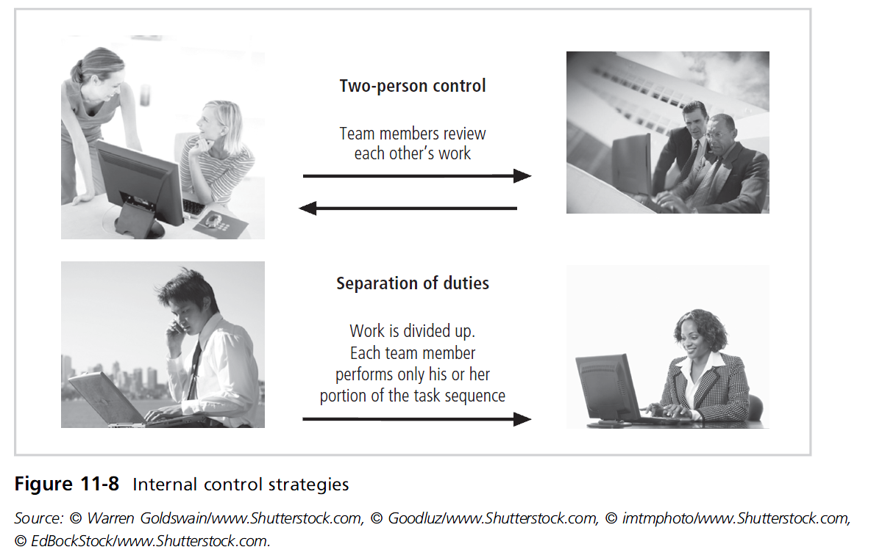
Principles of Information Security, Fifth Edition

Slide 48
Internal Control Strategies (cont’d)
Job rotation: Employees know each others’ job skills.
  Ensures no one employee performs actions that cannot be physically audited by another employee
Garden leave used by some companies to restrict the flow of proprietary information when an employee leaves to join a competitor
Least privilege: Only employees with real business need to use systems information are allowed to do so.
Principles of Information Security, Fifth Edition
Notes:
Internal Control Strategies
Job rotation: employees know each others’ job skills
Ensures no one employee performs actions that cannot be physically audited by another employee
Garden leave used by some companies to restrict flow of proprietary information when employee leaves to join competitor
Least privilege: only employees with real business need to use systems information allowed to do so

Slide 49
Privacy and the Security of Personnel Data
Organizations required by law to protect sensitive or personal employee information
Includes employee addresses, phone numbers, Social Security numbers, medical conditions, and family names and addresses
Information security groups should ensure these data receive at least the same level of protection as other important organization data.
Principles of Information Security, Fifth Edition
Notes:
Privacy and the Security of Personnel Data
Organizations required by law to protect sensitive or personal employee information
Includes employee addresses, phone numbers, Social Security numbers, medical conditions, and family names and addresses
Information security groups should ensure this data receives at least same level of protection as other important organization data

Slide 50
Summary
Positioning the information security function within organizations
Issues and concerns about staffing information security
Professional credentials of information security professionals
Organizational employment policies and practices related to successful information security
Principles of Information Security, Fifth Edition

Slide 51
Summary (cont’d)
Special security precautions for nonemployees
Separation of duties
Special requirements needed for the privacy of personnel data
Principles of Information Security, Fifth Edition

